Slide 1


Jeebly SSP
Presented By-
Abhishek Kumar
Mentored by-
Neelam Rawat Mam

Slide 2

Introduction
In the fast-paced world of logistics, where the efficient movement of goods is pivotal to economic growth and global trade, the integration of innovative technology has become indispensable. At the forefront of this digital revolution lies your project: the Logistics Self-Service Portal, equipped with groundbreaking features designed to streamline logistics processes, enhance transparency, and elevate customer experience to unprecedented levels. This introduction serves as a beacon, illuminating the transformative potential of your self-service portal project within the logistics landscape. Central to its design and functionality is the seamless integration of two essential features: shipment booking and tracking. These pillars of logistical efficiency empower users with the ability to initiate, monitor, and manage shipments autonomously, fostering.

Slide 3
SOFTWARE REQUIREMENTS
HTML
CSS
JAVA SCRIPT
CI(PHP)
MY SQL
Bootstrap
Google map and chart
Google analytics
Apache

Slide 4
Hardware Requirements
Processor i3 and above
4 GB Ram and above
Processor i3 and above

Slide 5
Modules Description
Order Placement:
Users can effortlessly place orders through the intuitive interface of the portal.The portal facilitates easy selection of desired services, products, or shipments, along with specifying delivery preferences
Order Tracking:
Real-time tracking functionality enables users to monitor the status and location of their shipments throughout the entire delivery process.
Transaction Transparency:
The portal provides comprehensive visibility into users' transaction history, showcasing past orders, deliveries, invoices, and payments.
Invoice Management:
Users have access to detailed invoices for each transaction, providing a breakdown of costs, including itemized charges, taxes, and any applicable discounts.

Slide 6
Module Description
Invoices are easily accessible through the portal, allowing users to review, download, and print them for their records or reconciliation purposes.
Cash on Delivery (COD) Facility:
The portal supports COD payments, allowing users to choose this option during order placement.
COD orders are seamlessly integrated into the tracking and transaction management system, providing visibility into payment status and reconciliation

Slide 7
OUTPUT
Place Order:- Choose from a wide range of logistics services and products.Specify your delivery preferences, including dates, special instructions, and packaging requirements.Enjoy the convenience of placing orders at your fingertips, anytime, anywhere.
Track Order:- Stay informed about the status and location of your shipments in real-time. Receive automated notifications for significant updates, such as package pickup, transit milestones, and estimated delivery times.Experience peace of mind knowing that you have complete visibility into the progress of your orders.
Transaction Transparency:- Access comprehensive transaction history, including past orders, deliveries, invoices, and payments.Gain insights into order details, shipping costs, taxes, and any additional charges incurred. Download transaction records for accounting or auditing purposes, ensuring transparency and accountability.
With our Self-Service Logistics Portal, you're in control of your logistics journey. Place orders with ease, track shipments with confidence, and access transparent transaction details whenever you need them. Experience the convenience and empowerment of self-service logistics management today

Slide 8

Conclusion
The development of our Self-Service Portal in Logistics marks a significant milestone in modernizing and enhancing the efficiency of logistics operations. By providing users with the ability to seamlessly place orders, track shipments, and access transparent transaction details, we have empowered them with greater control and visibility throughout their logistics journey.

Slide 9
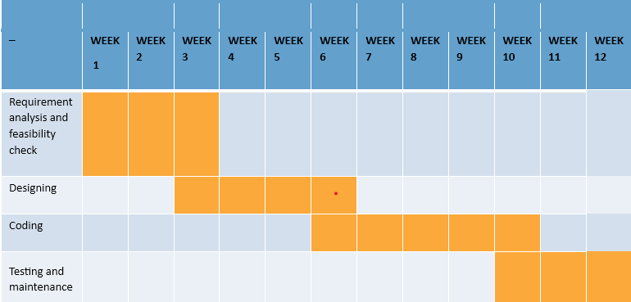
Gantt Chart

Slide 10

THANK YOU

